Slide 1



Smart4Energy
Visualizzazione status di apparati industriali tramite applicativo mobile

Slide 2

Il gruppo Carbon7
Adnan Latif Gazi (3° anno)
Leonardo Speranzon (3° anno)
Matteo Noro (3° anno)
Damiano D’Amico (4° anno)
Marco Odinotte (4° anno)

Slide 3




Funzionamento Generale
Virtual Display
Nodo Server
Remote Support

Slide 4




Front End
Virtual Display
Remote Support
A.A. 2021-2022
Smart4Energy – SWE Project - PB
‹#› / 17

Slide 5






Back End e Server
Piattaforma cloud per App
Server
Database
P2P Connection
Real Time communication
A.A. 2021-2022
Smart4Energy – SWE Project - PB
‹#› / 17

Slide 6

Automazione dello sviluppo
Gradle per lo sviluppo del VIrtual DIsplay
A.A. 2021-2022
Smart4Energy – SWE Project - PB
‹#› / 17

Slide 7

Libreria a supporto
Functional Reactive Programming Pattern Observer in React
A.A. 2021-2022
Smart4Energy – SWE Project - PB
‹#› / 17

Slide 8


Testing
Testing su Kotlin Virtual Display
Testing su React Remote Support
A.A. 2021-2022
Smart4Energy – SWE Project - PB
‹#› / 17

Slide 9






Gestione Sviluppo
Internal communication
Repository
Package Manager
IDE
A.A. 2021-2022
Smart4Energy – SWE Project - PB
‹#› / 17

Slide 10
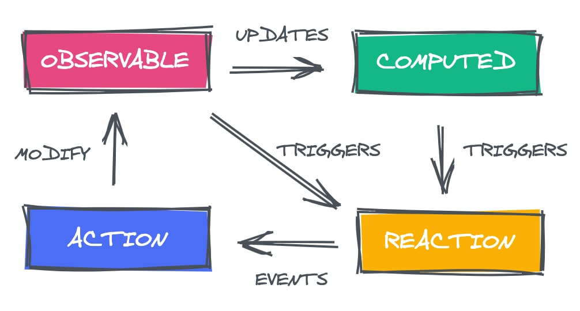
Design Pattern Virtual Display - MVVM
A.A. 2021-2022
Smart4Energy – SWE Project - PB
‹#› / 17

Slide 11
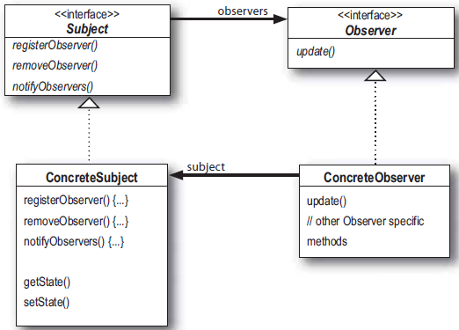
Design Pattern Remote Support - Observer
A.A. 2021-2022
Smart4Energy – SWE Project - PB
‹#› / 17

Slide 12
Avvio
Emulatore ModBus: ./ModbusSlave.exe –d . --dump
Virtual Display: Run from Android Studio
Remote Support: npm start
Server: node .\index.js
A.A. 2021-2022
Smart4Energy – SWE Project
‹#› / 17

Slide 13
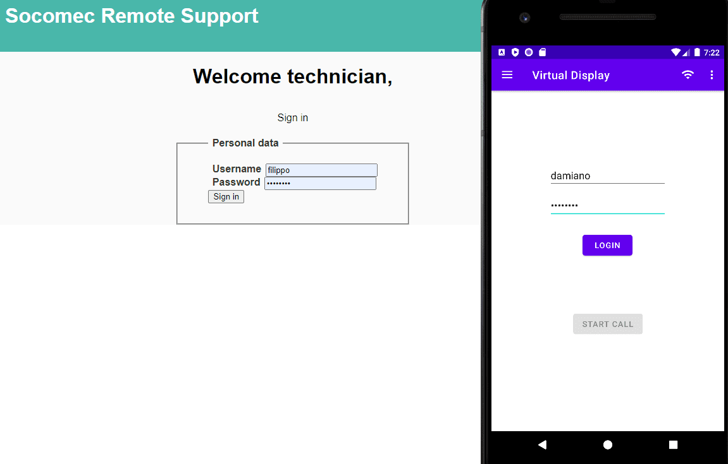
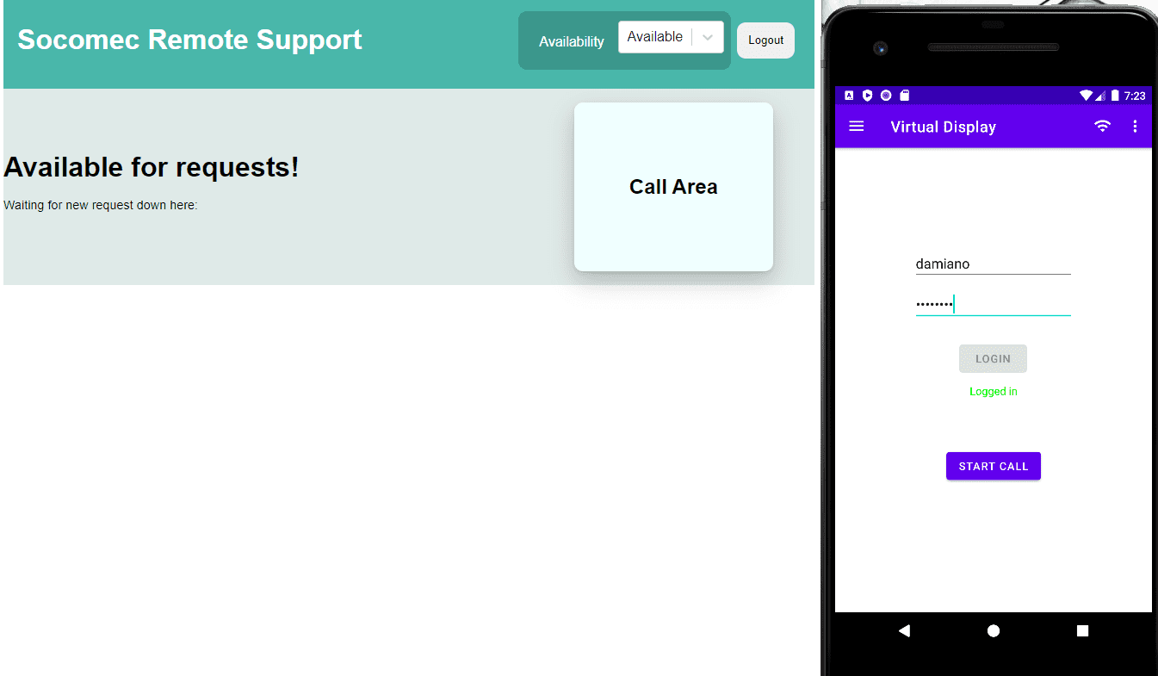
Login
A.A. 2021-2022
Smart4Energy – SWE Project - PB
‹#› / 17

Slide 14
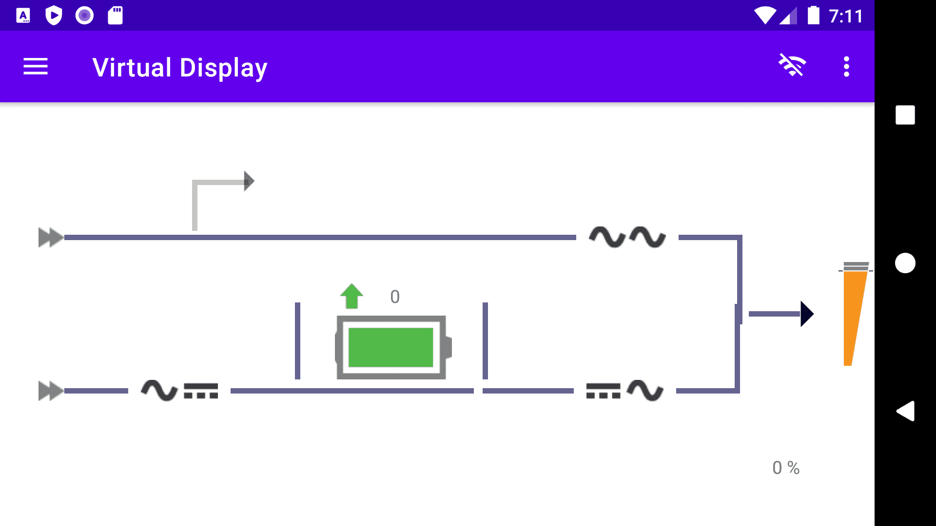
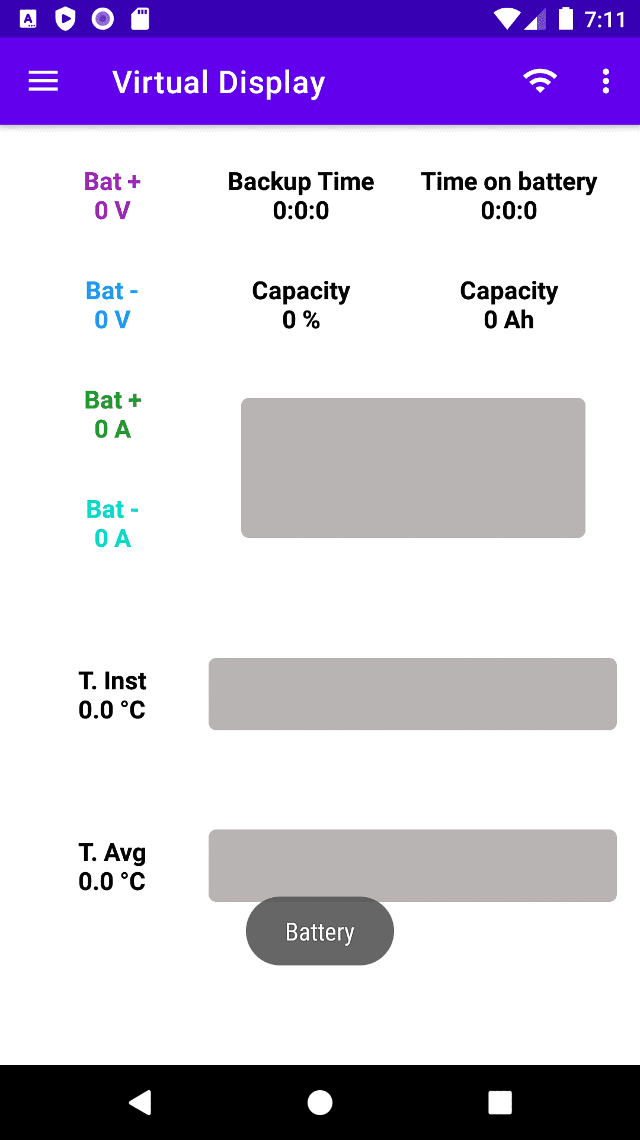
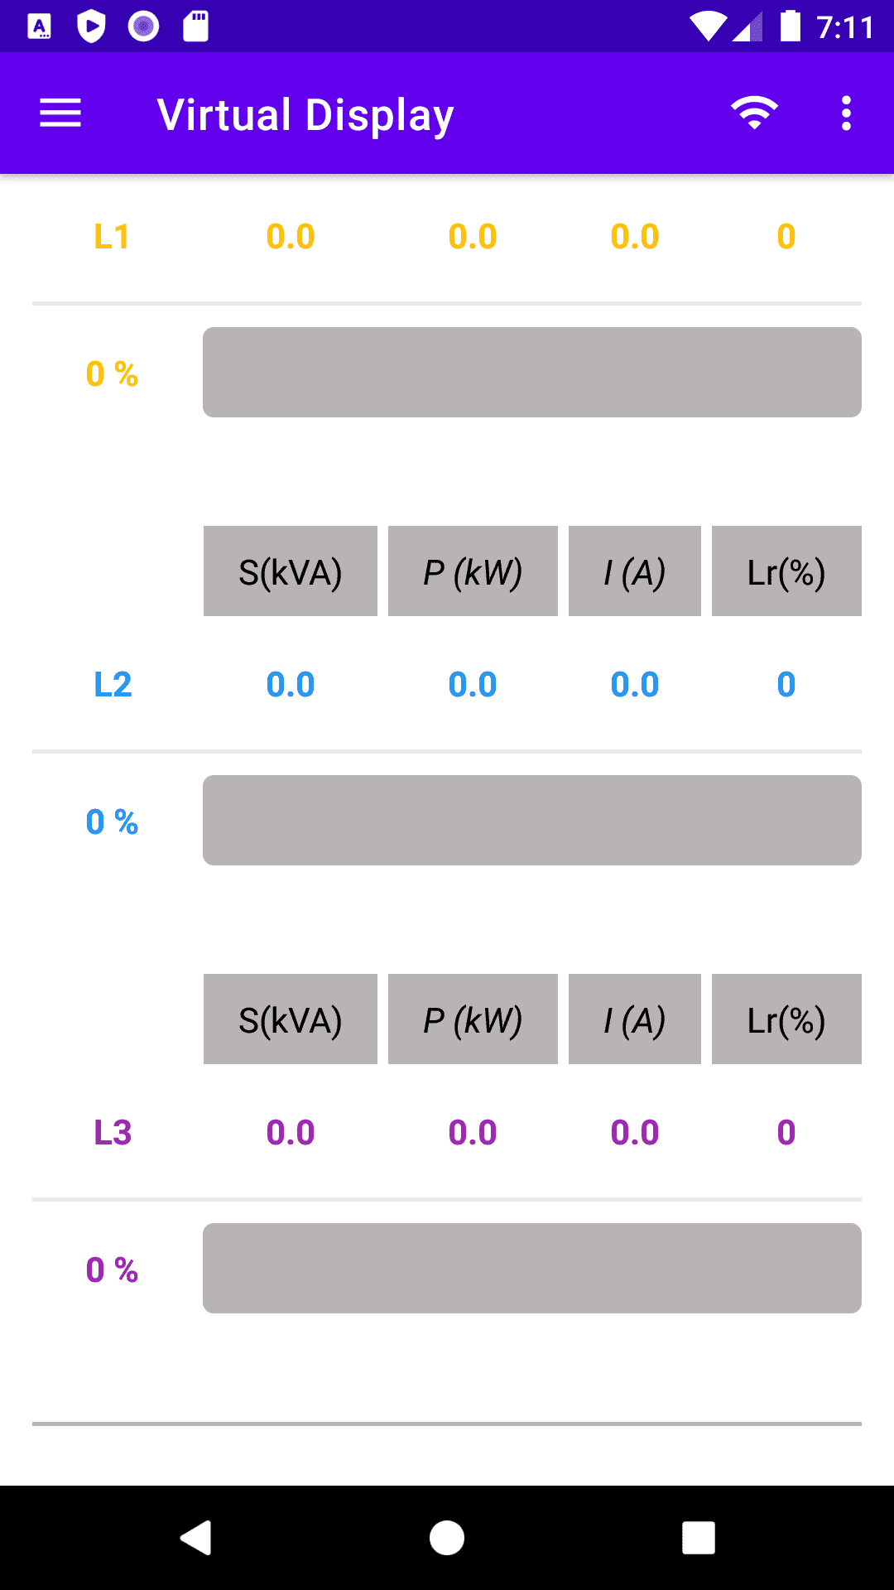
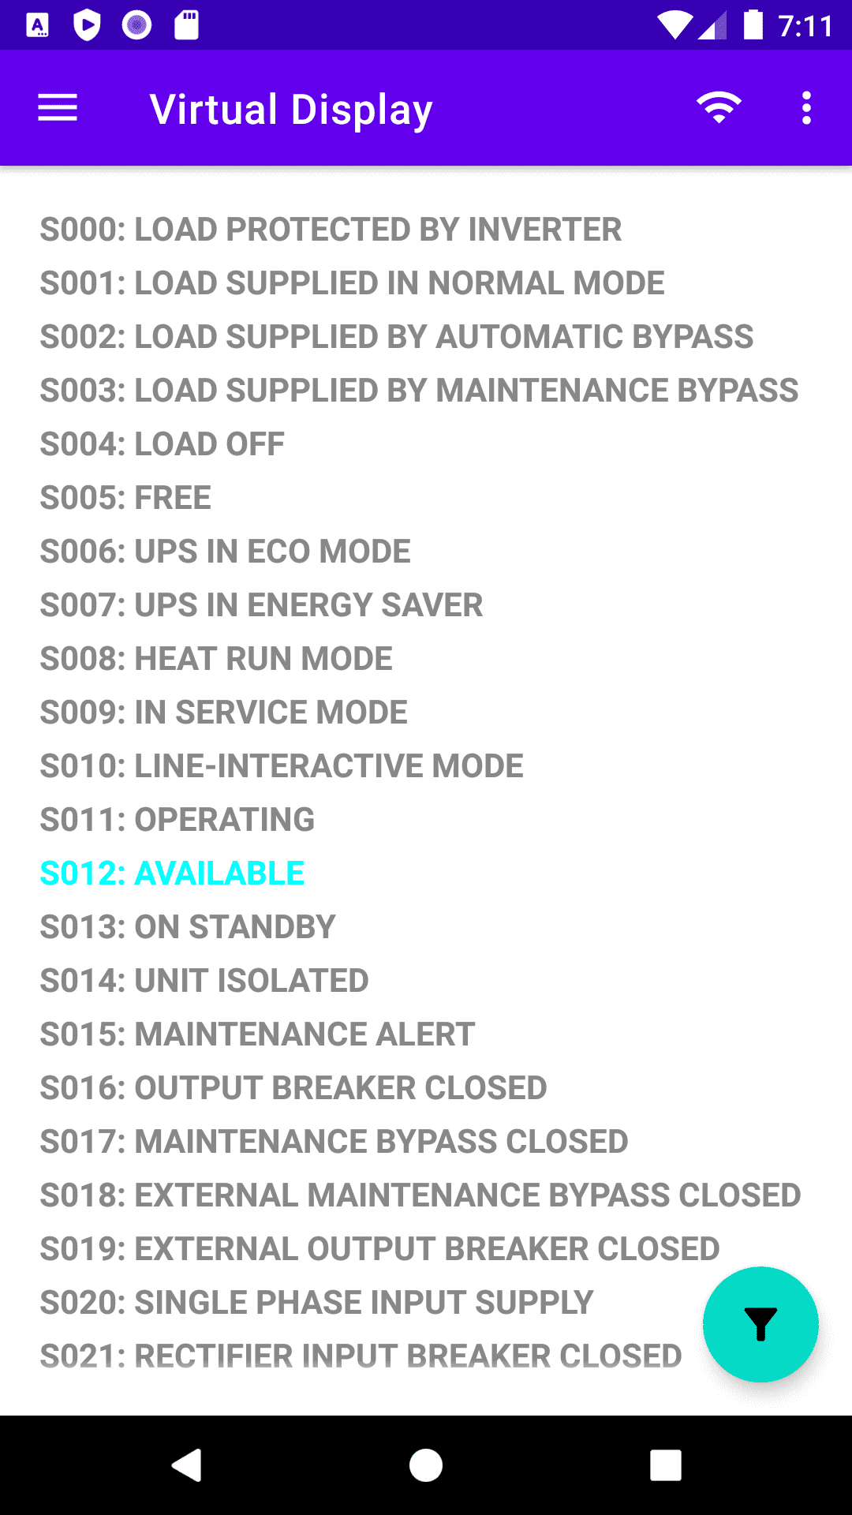
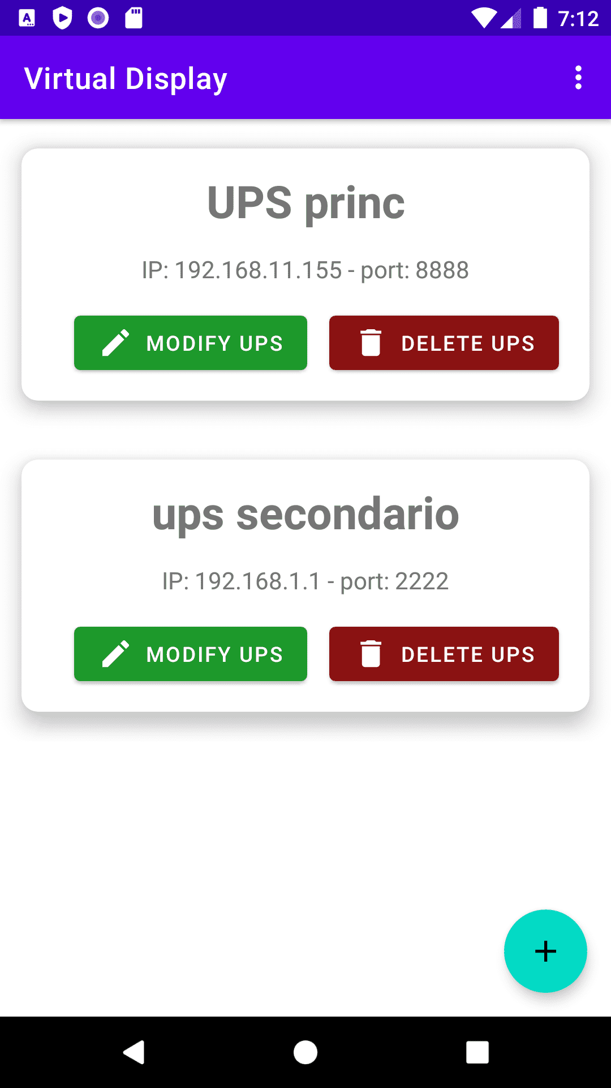
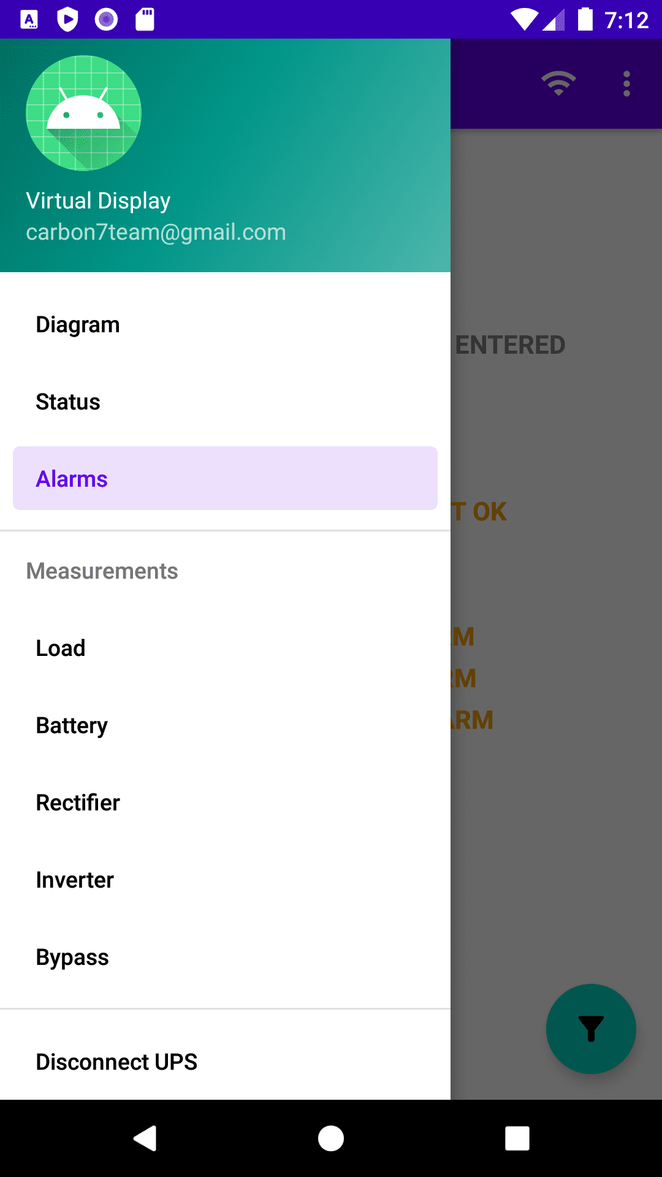
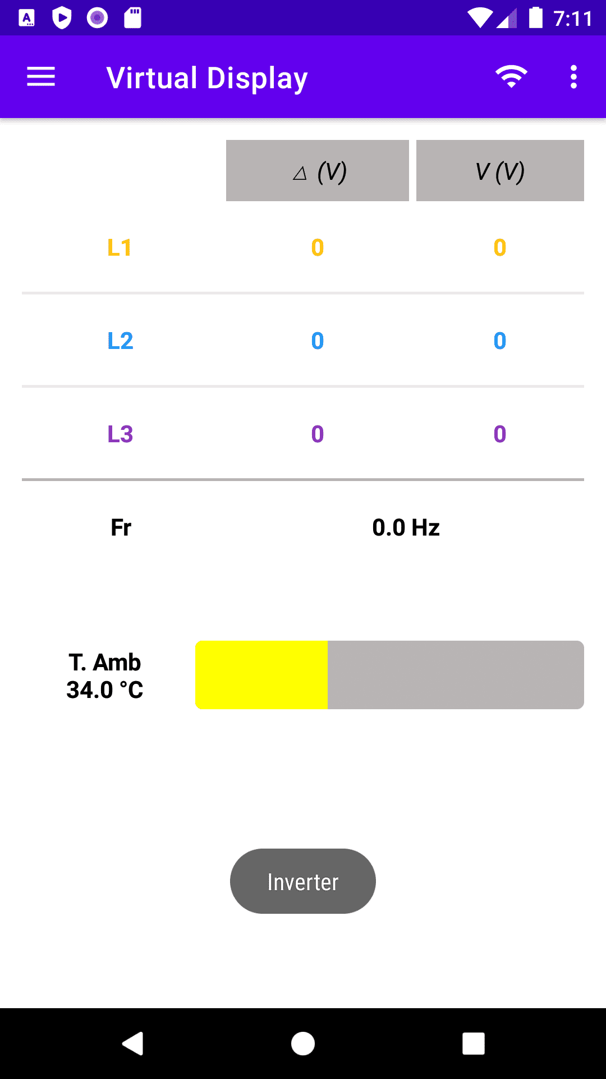
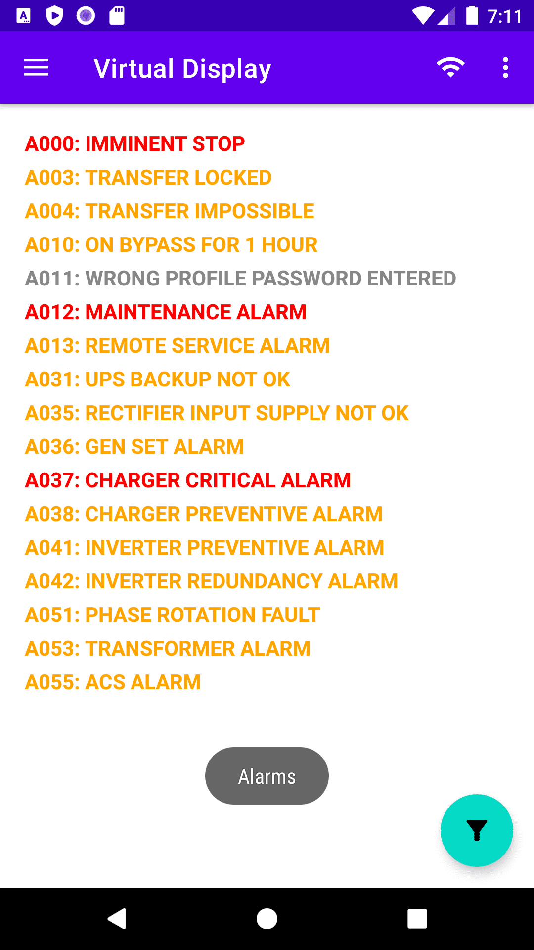
Virtual Display
A.A. 2021-2022
Smart4Energy – SWE Project - PB
‹#› / 17

Slide 15
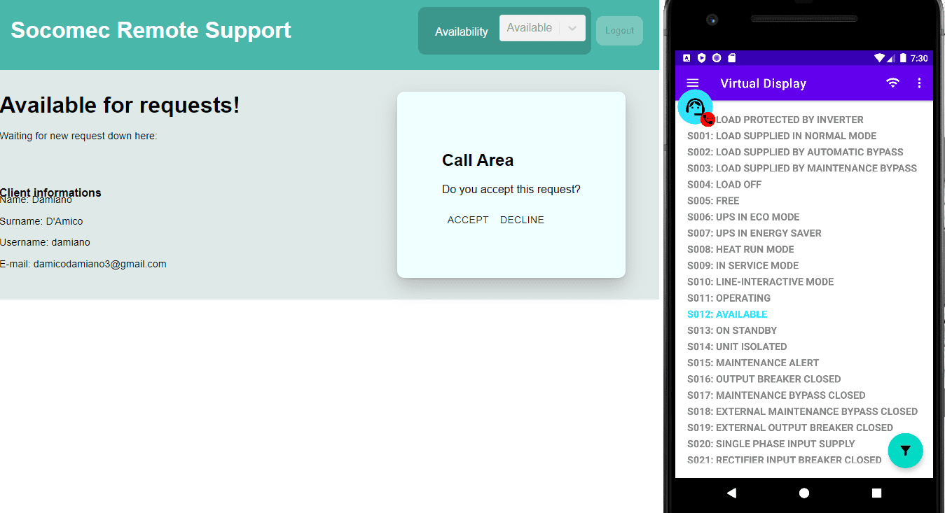
Assistenza Tecnica
A.A. 2021-2022
Smart4Energy – SWE Project - PB
‹#› / 17

Slide 16
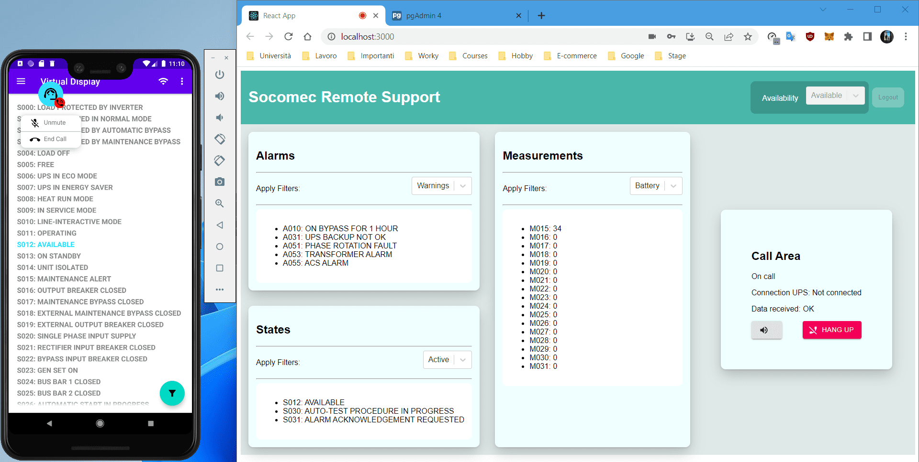
Assistenza Tecnica (2)
A.A. 2021-2022
Smart4Energy – SWE Project - PB
‹#› / 17

Slide 17
Grazie per l’attenzione
carbon7team@gmail.com
www.github.com/carbon7team

